Slide 1
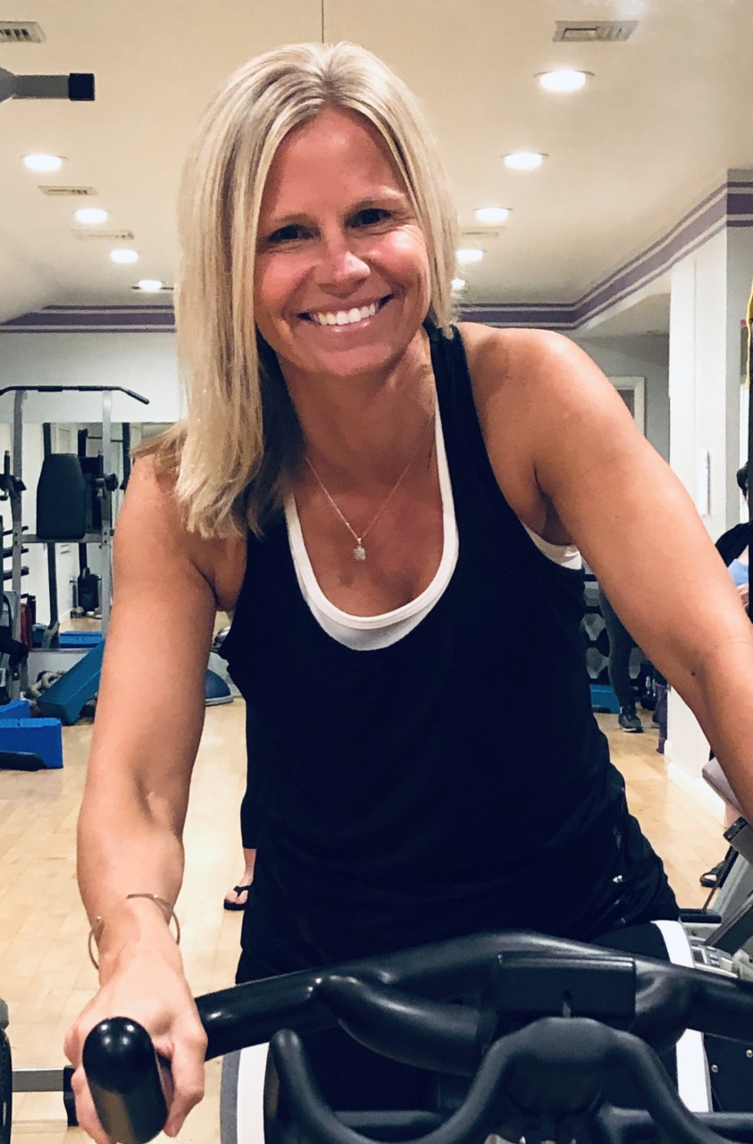
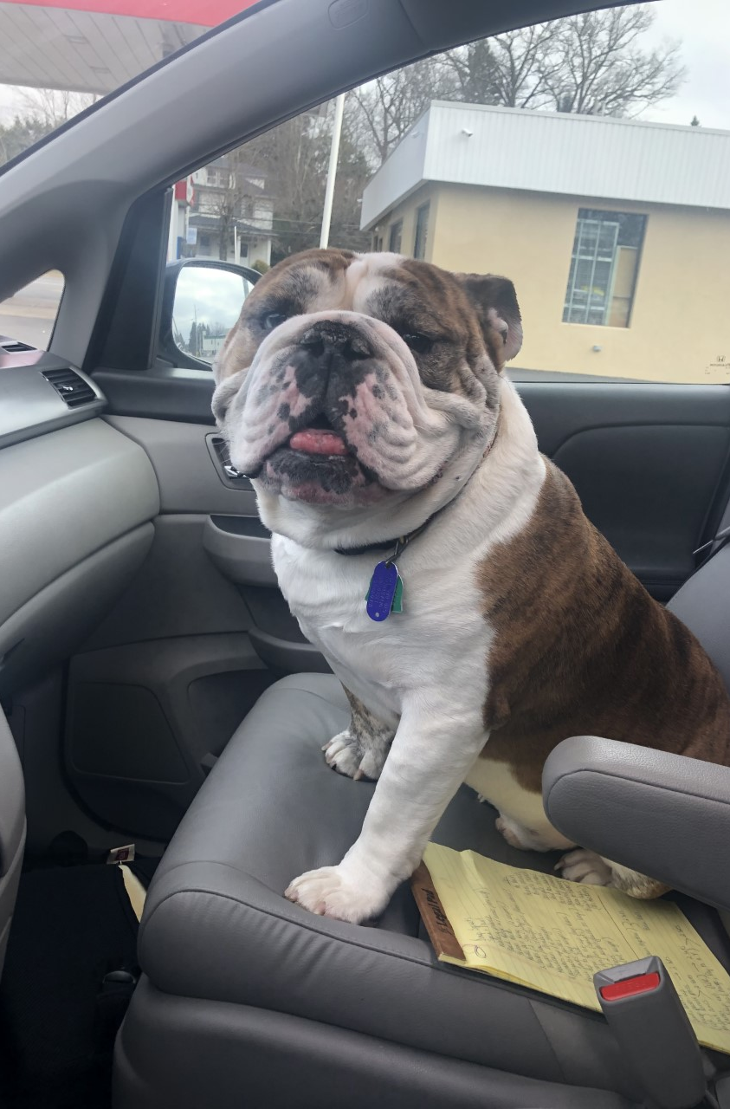
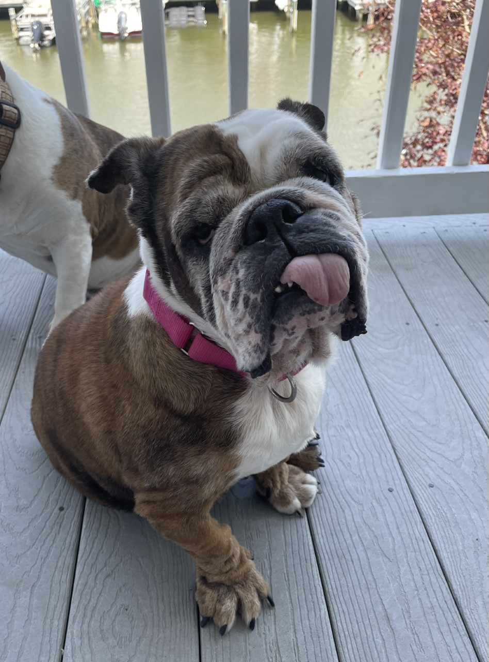


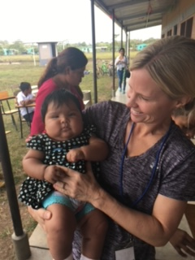


Slide 2

Let’s Talk
About it:
Effective Communication
Tina Rose, M.Ed.
Director of Professional Development & Programming

Slide 3

What is Communication?
Transferring information from one place to another
Conveying or sharing ideas and information
The means of sending/receiving information
The exchange of ideas, feelings or meaning between two or more persons

Slide 4
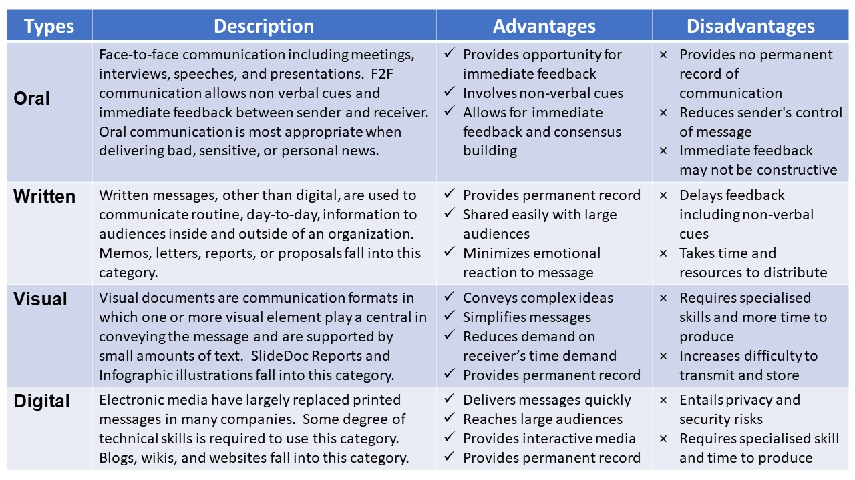

Slide 5

What is Digital Communication?
An organization’s online communication efforts
Most organizations today use a wide range of digital communication channels—from their website to mobile chat to blogs—to connect with current and prospective customers, employees, and other stakeholders.
Digital marketing professionals leverage this merging of technology and messaging to their advantage.
Digital communications professionals are responsible for everything from creating online brand assets to building an engaged social media audience.

Slide 6
Examples?
World Wildlife Federation (WWF)
Airbnb
Cadbury Worldwide Hide

Slide 7
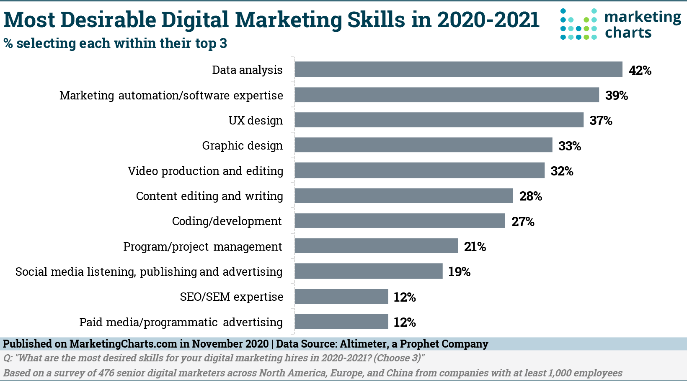

Slide 8
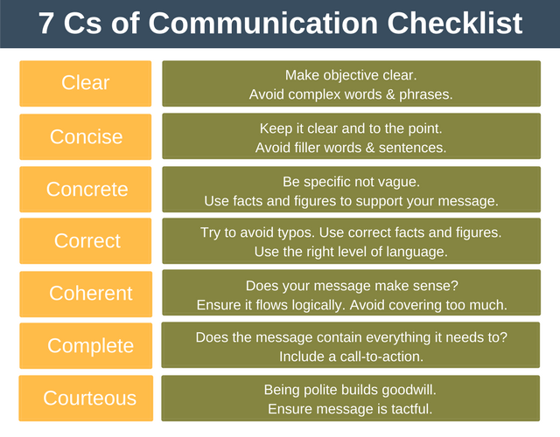
https://expertprogrammanagement.com/2018/04/7-cs-communication/

Slide 9
4 Communication Styles
Assertive
Aggressive
Passive-aggressive
Submissive

Slide 10

Assertive Style
Assertive communication involves clear, honest statements about your beliefs, needs, and emotions.
It is a healthy midpoint between passive communication and aggressive communication.
When you communicate assertively, you share your opinions without judging others for theirs.
You advocate for yourself when necessary, and you do it with politeness and consideration because assertiveness involves respect for your own ideas and those of others.
This communication style is useful for solving conflicts collaboratively.
Assertiveness communication allows you to express your needs productively and work with the other person to find the best solution.
Accepting compliments

Slide 11
Assertive Style:
Non-Verbals
Voice: Medium pitch, speed, and volume
Posture: Open posture, symmetrical balance, tall, relaxed, no fidgeting
Gestures: Even, rounded, expansive
Facial Expressions: Good eye contact
Spatial Position: In control, respectful of others

Slide 12
Assertive Style
Express feelings clearly, appropriately, and respectfully
Use “I” statements
Communicate respect for others
Listen well without interrupting
Feel connected to others
Feel competent and in control
Not allow others to abuse or manipulate them
Stand up for their rights

Slide 13
Assertive Style (Language)
“Please would you turn the volume down? I am trying to concentrate on my studying.”
“I am sorry, but I won’t be able to help you today. I have a dentist appointment.”
“Thanks for thinking of me, but I'm going to say no this time.”
“Unfortunately, I can't take on any more tasks at the moment.”
“Please don't walk away from me while we're having a conversation.”
“I respect your opinion, but let's agree to disagree.

Slide 14
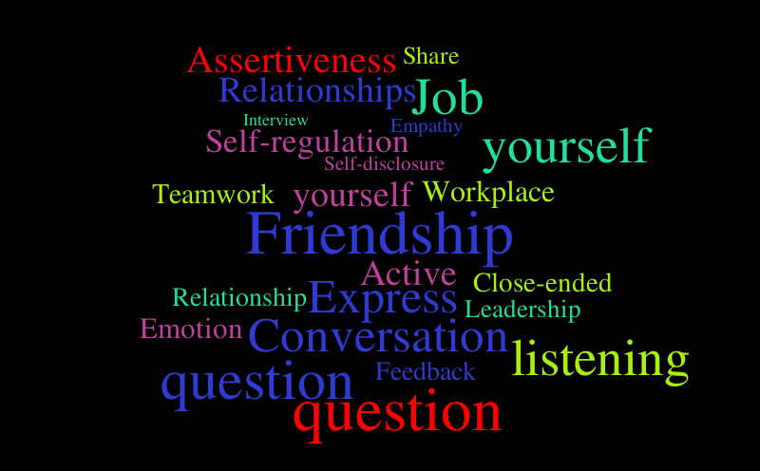

Assertive Communication
ASSERTIVE COMMUNICATION is a style in which individuals clearly state their opinions and feelings, and firmly advocate for their rights and needs without violating the rights of others. These individuals value themselves, their time, and their emotional, spiritual, and physical needs and are strong advocates for themselves while being very respectful of the rights of others.
This Photo by Unknown Author is licensed under CC BY-NC-ND

Slide 15

The Impact of Assertive Communication
Feel connected to others
Feel in control of their lives
Are able to mature because they address issues and problems as they arise
Create a respectful environment for others to grow and mature

Slide 16
The Aggressive Style
A style in which individuals express their feelings and opinions and advocate for their needs in a way that violates the rights of others. Thus, aggressive communicators are verbally and/or physically abusive.

Slide 17
Aggressive Style
Try to dominate others
Use humiliation to control others
Criticize, blame, or attack others
Very impulsive
Low frustration tolerance
Speak in a loud and demanding tone
Act threateningly and rudely
Poor listeners
Interrupt frequently
Use “you” statements
About “winning”
Generate fear and hatred in others
Always blame others instead of owning their issues

Slide 18
Aggressive Style:
Non-Verbals
Voice: Loud
Posture: Bigger than others
Gestures: Big, fast, sharp/jerky
Facial Expressions: Scowl, frown, and glare
Spatial Position: Invade others’ personal space, try to stand “over” others

Slide 19
Aggressive Style (Language)
“I’m superior and right and you’re inferior and wrong.”
“I’m loud, bossy and pushy.”
“I can dominate and intimidate you.”
“I can violate your rights.”
“I’ll get my way no matter what.”
“You’re not worth anything.”
“It’s all your fault.”
“I’m entitled.”
“You owe me.”
“I own you.”

Slide 20

Passive-Aggressive Communication
…is a style in which individuals appear passive on the surface but are really acting out anger in a subtle, indirect, or behind-the-scenes way. People who develop a pattern of passive-aggressive communication usually feel powerless, stuck, and resentful – they feel incapable of dealing directly with the object of their resentments. Instead, they express their anger by subtly undermining the object (real or imagined) of their resentments.

Slide 21

Passive-Aggressive Style
Sarcastic
Indirectly Aggressive
Devious
Unreliable
Patronizing
Gossip
Two-faced

Slide 22
Passive-Aggressive Style (Language)
“Why don’t you just go ahead and do it. My ideas aren’t good anyway.”
“Oh, don’t you worry about me. I can figure it out—like I always do.”
“That’s a great car, it’s almost as nice as John’s.”
“I love your new dress, I wish I had one like that, but I think I’m too skinny for that style.”
“I wish I could afford a new car like yours, but unfortunately all my money goes to my student loans.”

Slide 23
Passive-Aggressive Impacts
Anxious because life seems out of their control
Depressed because they feel stuck and hopeless
Confused because they ignore their own feelings
Real issues are never addressed
Unable to grow and mature
They get walked on

Slide 24
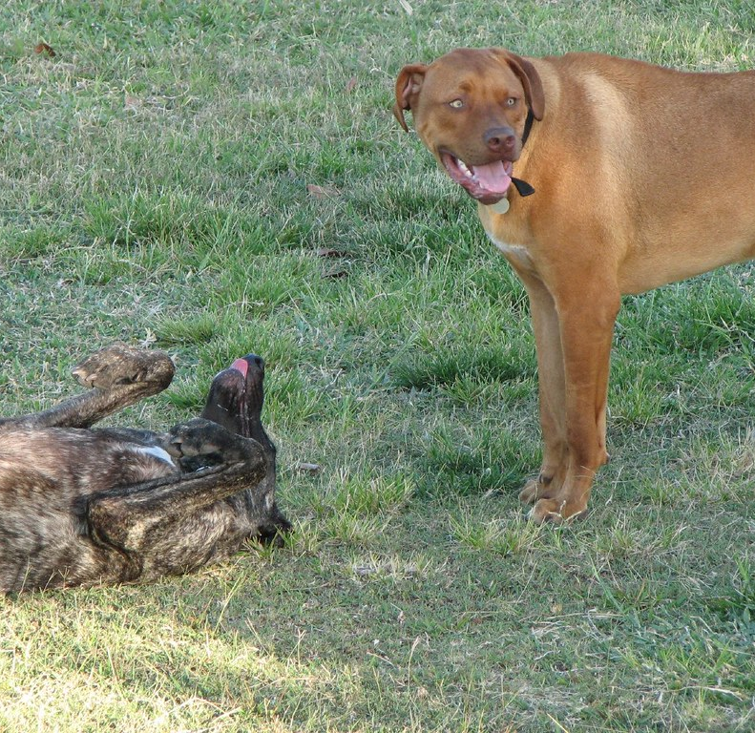
The Submissive Style
…is about pleasing other people and avoiding conflict. A submissive person behaves as if other people’s needs are more important, and other people have more to contribute.

Slide 25
Submissive Style
Apologetic
Avoid confrontation
Yield to someone else’s preferences
Opting out
Blame others
Feel like a victim
Refuse compliments
Inexpressive (of feelings and desires)

Slide 26
Submissive Style: Non-Verbals
Voice: Volume is soft
Posture: look down, try to make themselves small
Gestures: Twist and fidget
Facial Expression: No eye contact
Spatial Position: make themselves smaller/lower than others
Martyr-like attitude: (victim mentality)

Slide 27
Submissive Style (Language)
“Oh, it’s nothing, really.”
“That’s alright, I didn’t want it anymore.”
“You choose. I don’t care.”
“I get stepped on by everyone.“
“Don’t worry about me. I will be fine.”
“I will let you decide what is best.”

Slide 28
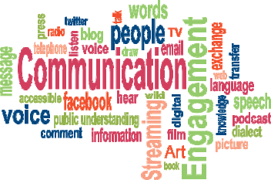
What is your Style?
(small groups)

Slide 29

Why is knowing important?
Your style affects your relationships, your career, and emotional well-being
Helps you strengthen your positive traits and work on improving those that are negative
Work better in teams
Affects how others perceive us and react to us
Increased productivity
Strong Management
Provides everyone a voice
Clear goals and expectations

Slide 30
Inclusive Communication
It is an overarching approach which is relevant to: everyone and in all situations, not just people with communication support needs. All communication at individual, organization and population levels. All modes of communication – face-to-face, telephone, written, online.
Inclusive communication is free from language that perpetuate stereotypes, negative expectations or limitations. By adapting your language, you can involve your entire audience more fully and inspire them to contribute more confidently

Slide 31
The Three Principles of Inclusive Communication
Inclusive language values the importance of words and the impact they have.
IC is free from language that perpetuate stereotypes, negative expectations or limitations.
By adapting your language, you can involve your entire audience more fully and inspire them to contribute more confidently.

Slide 32
Understanding Inclusive Communication
Diversity:
The seen and unseen characteristics and experiences, visible and invisible, which define who we are and how we experience the world around us. These include (but are not limited to) gender, race, ethnicity, sexual orientation, disability, religious and cultural background, familial status, age, languages spoken, and more.
Inclusion:
Creating an environment of respect, connection and community, where all people can feel respected and valued. Inclusion means that all perspectives and contributions are valued, and team members are empowered to be their full, authentic selves.

Slide 33
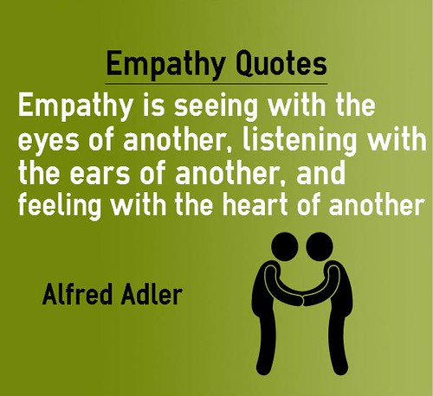
Principle 1: Empathy
Do not approach inclusion (or specifically inclusive communication) as a checklist of experiences or accommodations to check off a list. Instead, connect empathetically with your audience. Think about their experiences and how language and communication can impact the way they absorb your message. For example, consider the need for employees to use a name other than what’s on their legal documents.
https://www.youtube.com/watch?v=XXb2awAbmUA

Slide 34

Principle 2: Culture
Communication is only one part of culture. Work with your community to build inclusive company culture, bottom up not top down.
Work with your community groups by empowering them and giving them a voice in your communications. They know their community better than anyone — ask for their experiences, listen and take them to heart. Consider a program that features their stories and experiences in official communication. This empowers them, gives them visibility and gives more authenticity to your communication.

Slide 35

Principle 3: Empowerment
Provide tools for inclusion and showcase role model behavior.
Leaders are role models, whether they want to be or not, whether they are good role models or not, they become role models as everyone looks up to them. They need your support including coaching and guidance to be experts in communication. They set the bar for the rest of the company so empowering them goes a long way for your organization.
And provide resources, like inclusive language guides, books and resources for everyone in your organization so people can build their own skills, awareness and grow. You have to meet people where they are and give them the tools to grow.

Slide 36
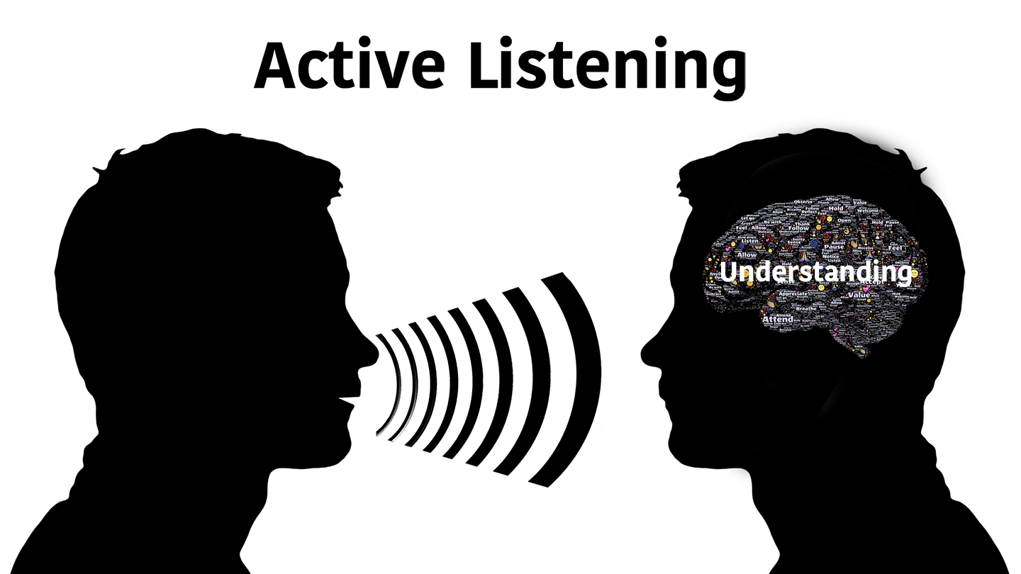

Slide 37

Art of Listening is…
Finding out what the speaker thinks about something
A choice
Letting someone know you care
A free flow of ideas that are truly listened to can lead to a workplace where employees are constantly learning from each other.
Repeating, paraphrasing, reflecting
Encourages respect

Slide 38

This Photo by Unknown Author is licensed under CC BY-SA

Slide 39
References
https://www.berkeleywellbeing.com/assertive-communication.html
https://www.coursera.org/articles/assertive-communication
https://www.mirecc.va.gov/cih-visn2/Documents/Patient_Education_Handouts/Assertive_Communication_Version_3.pdf
https://www.coursera.org/articles/workplace-communication
https://www.businessnewsdaily.com/9488-diversity-inclusive-communication.html
https://www.forbes.com/sites/forbescoachescouncil/2016/06/07/11-ways-male-leaders-can-adjust-communication-in-order-to-be-more-inclusive-to-women/?sh=74c4e7064638
https://www.rcslt.org/speech-and-language-therapy/inclusive-communication-overview/
https://medium.com/sarah-cordivano/inclusive-communication-three-principles-cb8dbb6361cd
https://thepowermoves.com/communication-styles/
https://thebetteryouinstitute.com/2017/11/21/communication-style-2/
https://www.forbes.com/sites/forbeshumanresourcescouncil/2021/09/08/the-art-of-listening-at-work/?sh=35d356c37785

